Slide 1
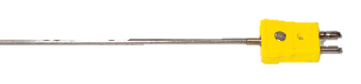
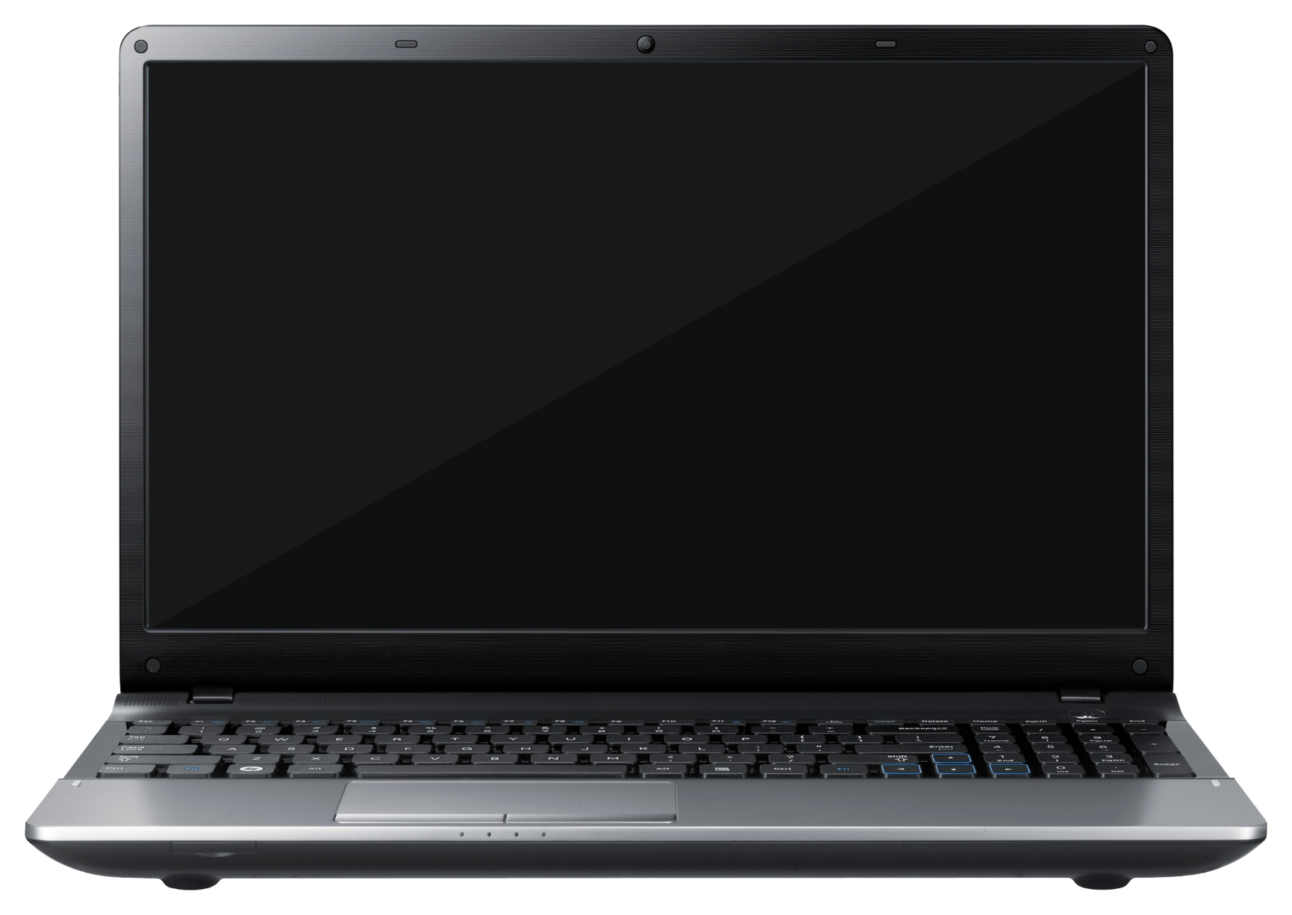
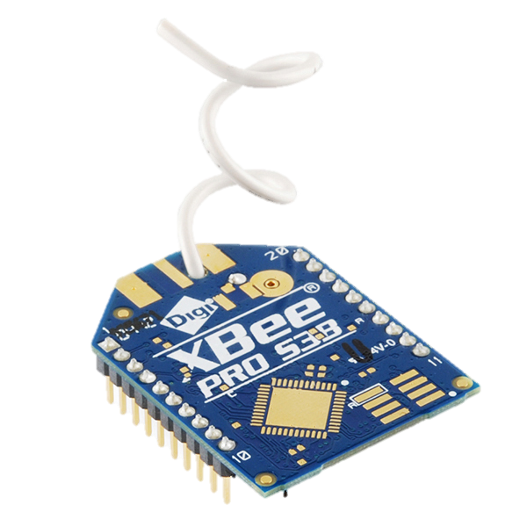
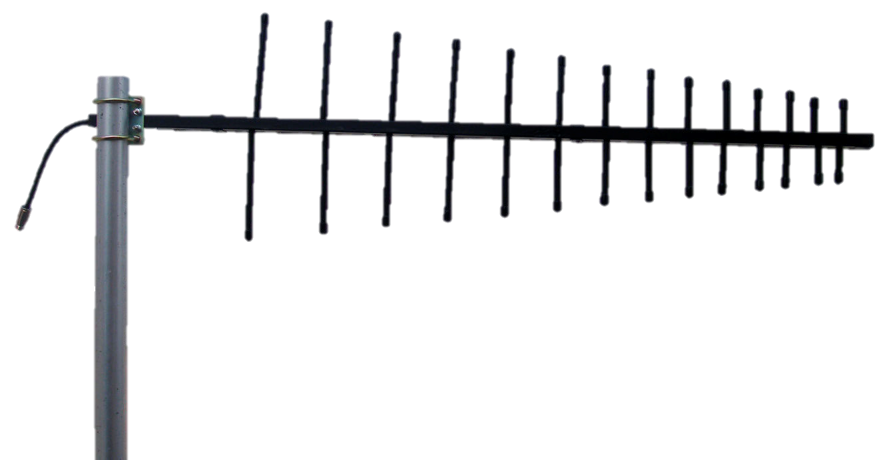


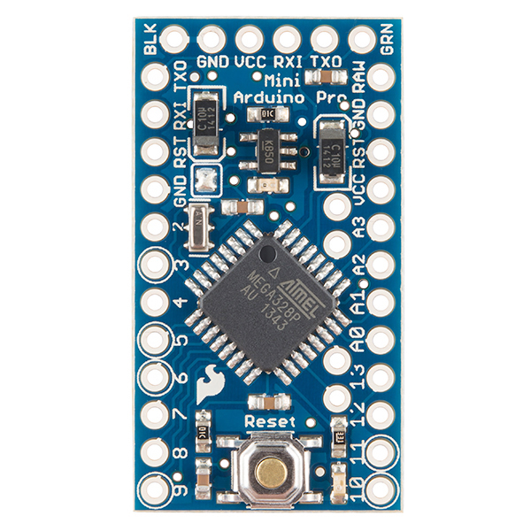
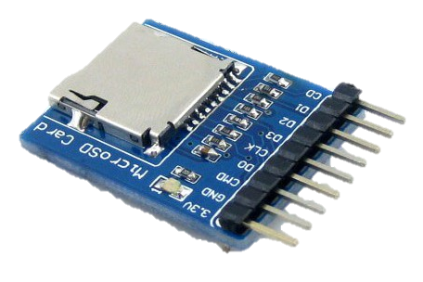
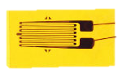
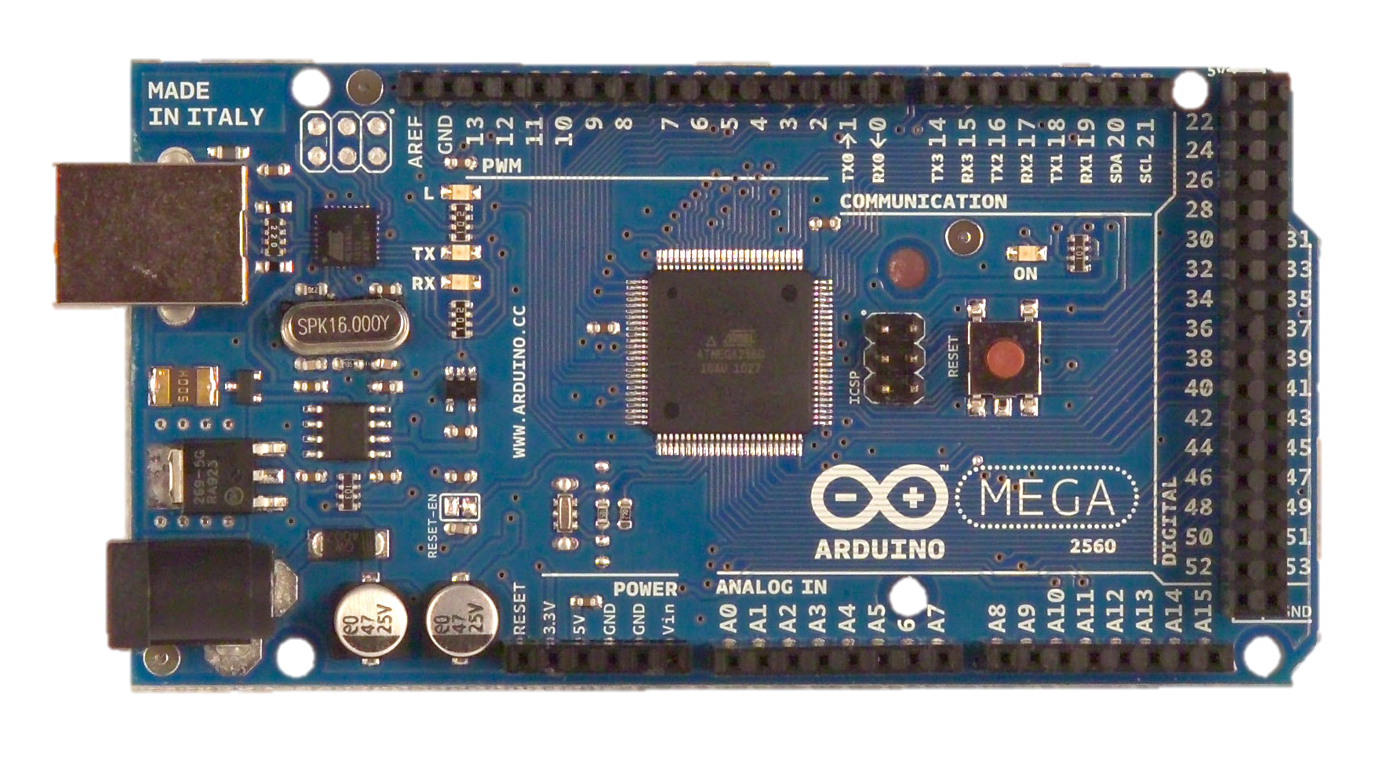
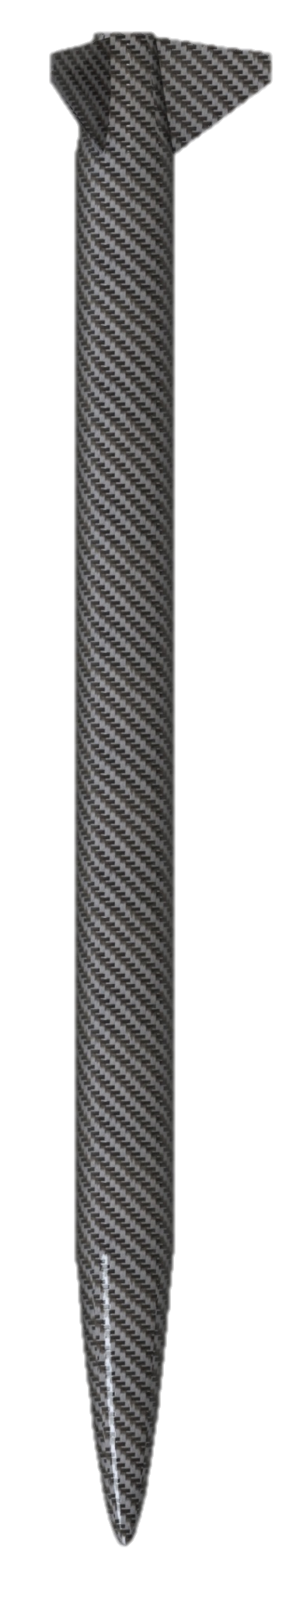
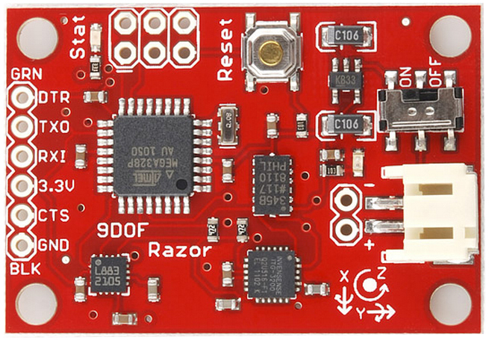
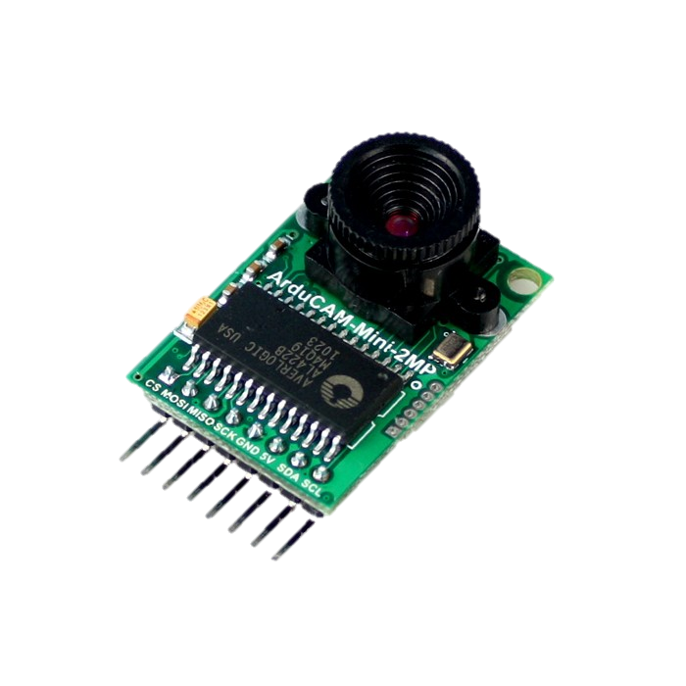


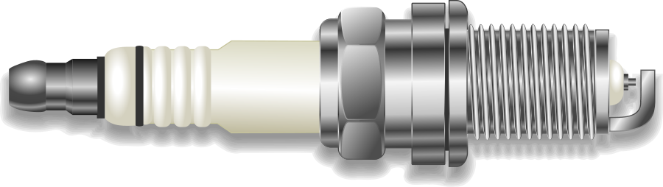
: Wireless
: Wired
Data & Communication Systems Architecture

Slide 2
References
http://flipmu.com/files/2011/12/ArduinoMega2650Front_21.jpg
https://cdn.sparkfun.com//assets/parts/7/6/9/4/11634-01.jpg
http://png-images.ru/wp-content/uploads/2015/02/02/4101/png/laptop_PNG5900.png
http://www.bhphotovideo.com/images/images1000x1000/Pelican_BB0050_0000_110_Hardigg_BB0050_BlackBox_5U_732914.jpg
http://www.clipartsfree.net/vector/large/21745-spark-plug-vector.png
http://www.uctronics.com/media/catalog/product/cache/1/image/9df78eab33525d08d6e5fb8d27136e95/a/r/arduino_mini_2mp_1.jpg
http://www.apexinst.com/uploads/prod/images/e085cf372577fab5120f3de0a0a90b9655a82524.jpg
http://www.robotshop.com/media/files/images/9-degrees-of-freedom-razor-imu-ahrs-compatible-large.jpg
http://www.omega.com/literature/transactions/volume3/images/strainpic1.jpg
http://www.liquidware.com/system/0000/3450/Pressure_Sensor_Top.jpg
http://www.robotshop.com/media/files/images/hitec-hs-5585mh-servo-motor-large.jpg
http://www.icra2013.org/wp-content/uploads/2012/11/09_MW_logo_CMYK1.jpg
http://innovo-lb.com/openkits/wp-content/uploads/2015/06/11113-02.jpg
http://www.inbuildingprojects.com/wp-content/uploads/2009/06/yagi.jpg
http://www.arduiner.com/1546-thickbox_default/microsd-card-breakout-board.jpg
http://www.omega.co.uk/pressure/images/PXM4102_l.jpg

